Slide 1
Concur Travel & Expense
Concur Training - overview

Slide 2
Concur Training Agenda
Today’s meeting will cover:
Concur Overview
How to Login and Navigate
User Profile Setup
Completing a Travel Request
Completing an Expense Report
Approval Workflow Process
Q &A

Slide 3
Concur Overview
What is Concur?
Concur is a comprehensive web-based tool that integrates travel request and expense reporting with a complete travel booking solution for higher education business travel.
Concur also offers the SAP Concur Mobile App to manage your expenses and business travel on your mobile device and/or tablet.

Slide 4
Concur Overview
Who can use Concur?
Employees Only (staff and faculty)
Travel being processed through Concur based on funds used
State-Side
Foundation (UFSS)
University Enterprises (UEI)- Request only
Travel for the following groups are not processed through Concur
Student
Non-Employee
Continue to process these types of travel using the current process in place.

Slide 5
Concur Overview
Concur has 3 Modules:
Request (Travel Request) – (Replaces the Travel Requisition or Travel PO) is required to obtain preapproval of your travel prior to making any travel reservations.
Travel (Concur Travel) – Concur Travel should be used to book airfare and make rental car and hotel reservations through the University’s travel management company (TMC), Christopherson Business Travel (CBT) either by using the online booking tool or booking directly with a CBT agent.
Expense (Expense Report) – (Replaces the Travel Claim) is required to request reimbursement for out-of-pocket expenses, and to reconcile any university prepaid transactions including US Bank Concur Travel Card transactions.
All Travel Request and Expense Reports will go through an integrated approval workflow in Concur.

Slide 6
The Travel Process
Step 1:
Complete Travel Request. Once approved….
Step 2:
Book Travel
(via Concur Travel or outside Concur)
Step 3:
Complete and submit Travel Expense Report after trip return.

Slide 7
US Bank Concur Campus Travel Card
Only airfare, car rental, & rail can be charged to the US Bank Campus Travel card. Hotel reservations will need to present a physical credit card in person at the time of payment (Individual Concur Travel card or personal credit card).
US Bank campus travel card transactions will upload to the traveler’s Concur account where they can attach them to an Expense Report.
Notes:
we have a new US Bank travel ghost card solely for Concur. it is already in Concur and users cannot see the ghost card number. it is linked to Concur Travel so when a traveler books an airline ticket, the ghost card will be charged directly. there is no reconciliation needed on the departments behalf. Once the transaction posts, it will come through to Concur and become available in Available expenses.

Slide 8
US Bank Individual Concur Travel Cards
New individual US Bank Concur Travel cards will be issued to all individuals who travel, with the approval of their supervisor & Dean,(if applicable). The card should be placed in your Concur user profile.
Travel card will only be used for university business travel transactions with the Concur program. Do not use this travel card for UEI funded travel expenses.
Ex. Registration, Lodging, Car Rental Fuel, Parking, Ground Transportation, Meals, etc.
All business-related expense should go onto this card to help reduce out-of-pocket expenses.
US Bank individual Concur card transactions will upload to the traveler’s Concur account where they can attach them to an Expense Report.
Credit card transactions can take approximately 7 business days to flow into Concur. All credit card transaction should be placed on expense report for reconciliation purposes.
Notes:
we have a new US Bank travel ghost card solely for Concur. it is already in Concur and users cannot see the ghost card number. it is linked to Concur Travel so when a traveler books an airline ticket, the ghost card will be charged directly. there is no reconciliation needed on the departments behalf. Once the transaction posts, it will come through to Concur and become available in Available expenses.

Slide 9
Approval Workflow
All Travel Requests and Expense Reports will go through an automated workflow process.
The Budget Approver has been designated by your Department Head and is based on Dept. ID/fund combination.
The “Reports To” Approver is your direct report provided by HR.
Depending on Travel Type and Travel Destination, additional approvals may be required for Travel Request.
In addition to required approvals, users and/or approvers can add additional approvers to the workflow to any particular Travel Request and/or Expense Report.

Slide 10
Approval Time Allowances
Request & Expense reports have the following time allowances:
Requests- 10 days
Expense reports- 10 days
Budget approver stage- Auto approve after time allowance
“Reports To” Approver stage- Will move onto their supervisor for approval

Slide 11
Accessing Concur
Eligible Sac State employees are already setup to use Concur. If you are not able to access Concur, please contact the University Concur Coordinator @ travel@csus.edu .
To access Concur, go to your My Sac State Homepage and click Concur Travel under the Faculty/Staff Related Links area.
Prior to using Concur, please review and complete your User Profile. Setting up your profile is important so that all the information in Concur is current and accurate for booking travel and getting the most out of the Concur Travel & Expense System.

Slide 12
Navigating Concur Homepage
Profile Access
Click here to return home anytime
Quick Task Bar
Use Trip Search to gather estimates for your Travel Request.
Once request is approved use to book travel reservations.
Concur updates will be here
Upcoming Trips will be listed here
US Bank Ghost & Individual Card Transactions will be here

Slide 13
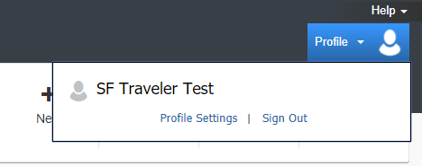
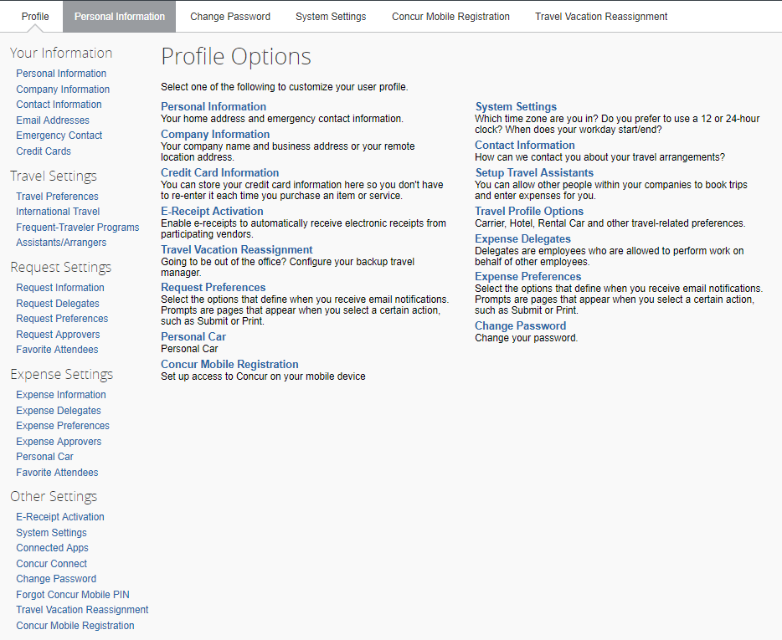
Completing User Profile
On the Concur Homepage, Click on Profile > Profile Settings.
Profile Options:
Your Information
Travel Settings
Request Settings
Expense Settings
Other Settings

Slide 14
Personal Information
Name-
Make sure your name is identical to the name on your photo identification if using Concur Travel to book airfare as the name in the system will be the name provided on your ticket. Otherwise, contact the Concur Coordinator prior to booking your airfare.
Contact Information-
A work or home phone number is required.
Email Addresses-
Your email address has been provided by HR. You can add additional email addresses.
You will want to verify your email address to be able to forward travel plans and receipt images to Concur.
Home Address-
Your home address is not required. This is used to set a default starting location for the Personal Car Mileage Calculator built into the expense report.
Does not update address mailing address for reimbursement checks. To update address please email vendordatarecordform@csus.edu

Slide 15
Request/Expense Settings
The following categories can be found in both Request Settings and Expense Settings. Once you assign it to one setting, it will automatically be assigned to the other, except for Preferences (Email)…
Settings | Descriptions
Preferences (Email) | Select options that define when you want to receive email notifications. Actual setting selections are different in both Request and Expense.
Information (chartfield) & Approvers (“Reports to”) | You can view this information. You cannot update this information, however you can change the chartfield on the actual Travel Request and Expense Report. “Reports to” Approver is your direct report provided by HR.
Delegates | By assigning permissions to a delegate, you are assigning permissions for Request and Expense.
Favorite Attendees | Attendees added to Request will also be added to Expense. The Attendee functionality can be used to enter attendee names that are present at a travel business entertainment event (Hospitality related).
Personal Car (Under Expense Settings Only) | In order to claim personal car mileage on an expense report, you need to add a car to your profile. The Vehicle ID is your license plate #. Mileage Rate Type is Personal (CSU current standard reimbursement rate) or Athletics.

Slide 16
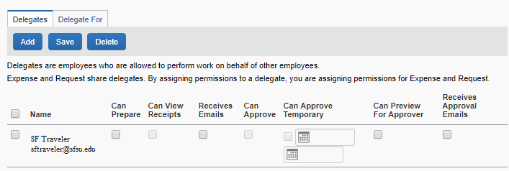
Delegate Permissions
Delegate - employee who is allowed to perform work on behalf of another employee. Delegate Permissions are only for Request and Expense. You will also need to add this delegate as an Assistant/Travel Arranger to allow them to book travel via Concur.
Traveler Permissions:
Prepare Travel Requests and Expenses Reports
View Receipt Images
Receive a copy of Email Notifications (No approval emails)
Approver Permissions: Approvers will have additional approval permissions to assign to a delegate.
Approve Travel Requests and Expenses Reports without date constraints
Approve Temporarily (beginning/end date required)
Preview Travel Request/Expense Report for Approver prior to Approval
Receive a copy of Approval Email Notifications
Traveler Permissions
Approver Permissions
Employee you assign “Can Approve” permission must already be an approver in Concur.

Slide 17
Travel Settings
Travel Preferences – Complete all fields if you will be Booking Travel via Concur so your preferences will be saved and to enhance your search results and reservation wishes using the online booking tool.
Travel Preferences | Descriptions
Air, Hotel, & Car Rental Preferences | Indicate any preferences such as seat selection, room type, accessibility needs, car transmission, etc.
Frequent- Traveler & Advantage Programs | indicate any programs/discounts such as AAA member, Government, frequent traveler numbers.
TSA Secure Flight -Required | Add date of birth and TSA Pre-check number.
International Travel: Passports and Visas | Add passport/International Visa information.
Assistants/Travel Arrangers | Add a primary Travel Assistant/Travel Arrangers.
Credit Cards- Required | US Bank Individual Concur Travel credit card should be added in order to guarantee hotel reservations.

Slide 18
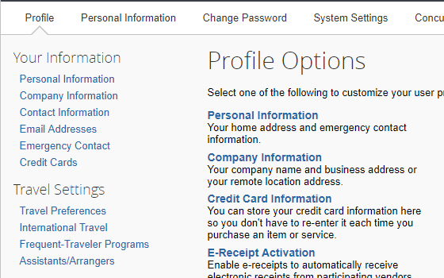
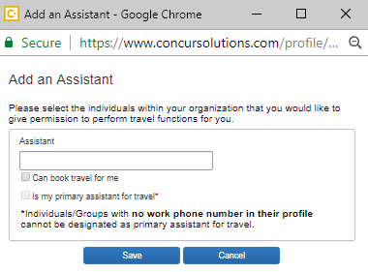
Assistants/Arrangers
Primary Travel Assistant vs. Travel Arranger – A Travel Arranger can perform travel functions such as book travel on a traveler’s behalf whereas a Primary Travel Assistant can also receive confirmation emails from CBT (Christopherson Business Travel) regarding the travel as well as update profile information.
In order to make someone a Travel Assistant/Arranger, you must also make them a delegate for Travel Request/Expense.

Slide 19
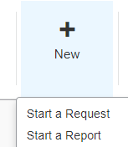
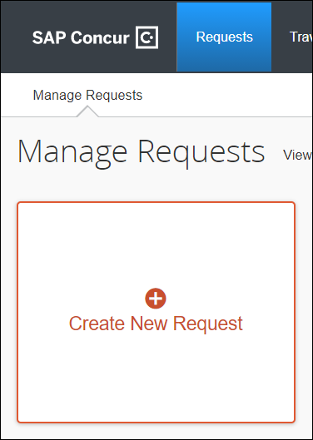
Creating a New Travel Request
To Create a New Travel Request from the Concur Homepage, you have two options:
On the Quick Task Bar, under New > Start a Request
OR
On the menu, click Requests > New Request

Slide 20
Creating a New Travel Request
Travel Request consists of the following areas:
Request Header
Expenses
Request Timeline
Audit Trail

Slide 21
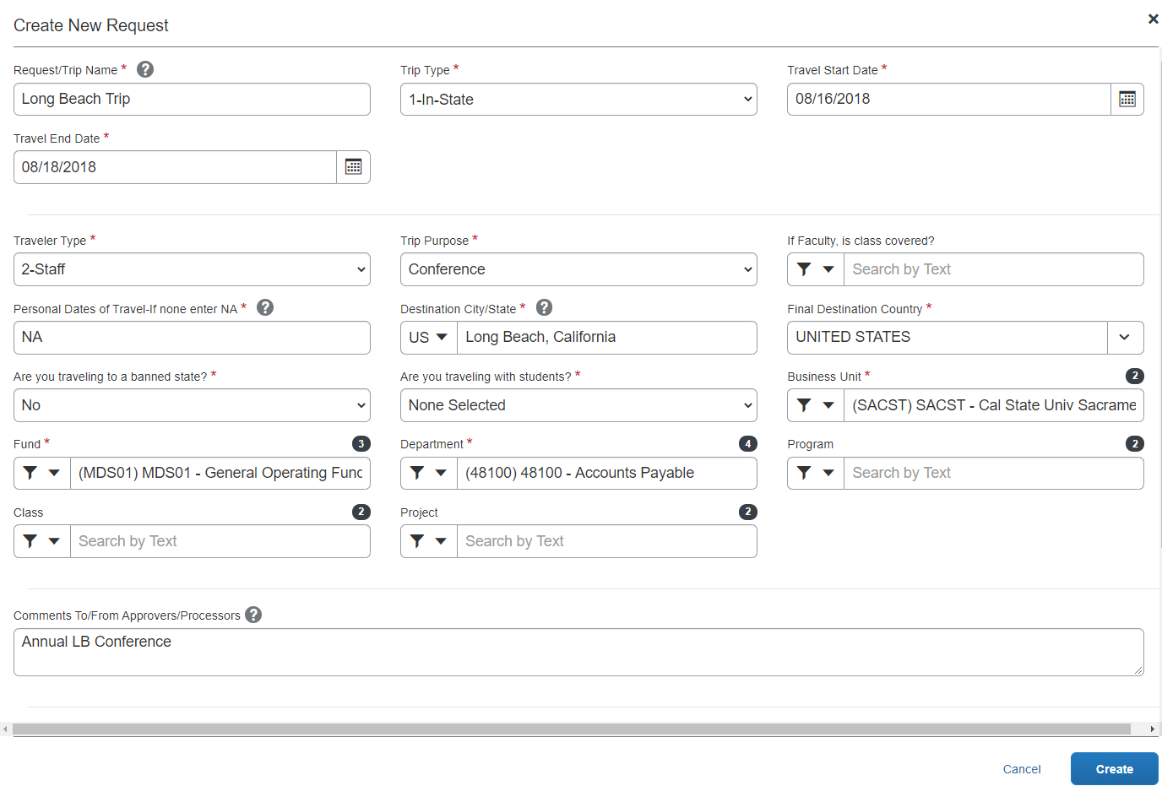
Request Header
Step 1: Complete Travel Request Header.
Step 2: Once Header is complete, click on Create.
All boxes with red asterisks (*) are required fields.
Do you have a plan/substitute for your classes while you are away? Yes, No?
1-Faculty
2- Staff
Chartfield default is MDS01 & your Dept. ID is populated from HR.

Slide 22
Segments
You can provide estimates for the following additional Expense Types: Personal Car Mileage, Ground Transportation and Parking/Tolls.
You will need to estimate your expenses for the fiscal year.
You will need to register a car under Profile > Profile Settings > Personal Car in order to add Personal Car Mileage Expense Type to an Expense Report.

Slide 23
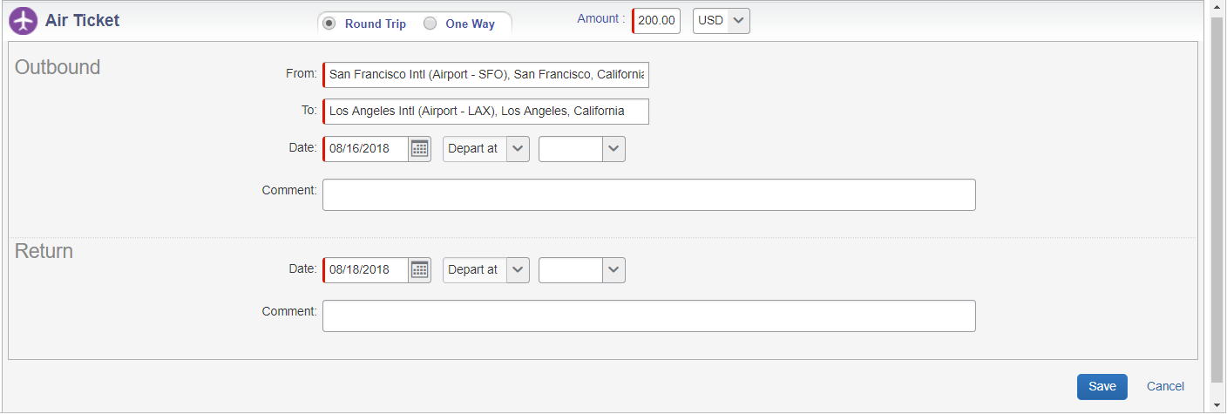
Airfare
The dates will populate and move over from the Request Header. Fill in all estimated amount and optional fields if you like and click Save.
Enter an estimated Amount

Slide 24
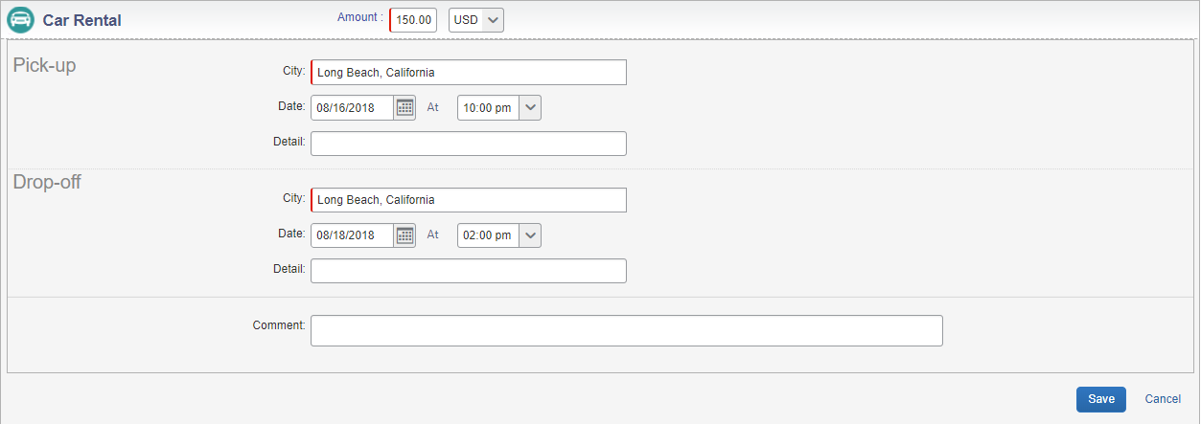
Car Rental
The dates will populate and move over from the Request Header. Fill in all estimated amount and optional fields if you like and click Save.
Enter an estimated Amount
Click Save when done.

Slide 25
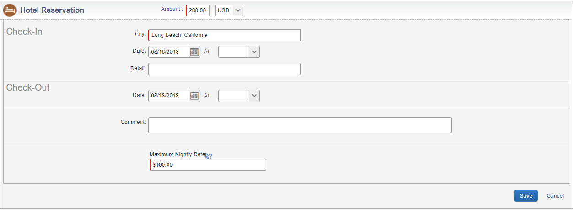
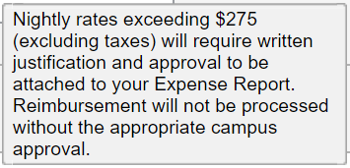
Hotel
Fill in the estimated amount for the complete hotel stay and optional fields if you like
Enter Maximum Nightly Rate that you anticipate your hotel room will be. If your hotel total is above $275 before tax, you will need to attach the Authorization for Exception to Travel form to your Expense Report. Please have the form approved prior to booking your hotel stay to ensure full reimbursement.
Click Save.
Enter an estimated Amount
Tip indicator: this message will appear..
Enter estimated max nightly rate you may have.

Slide 26
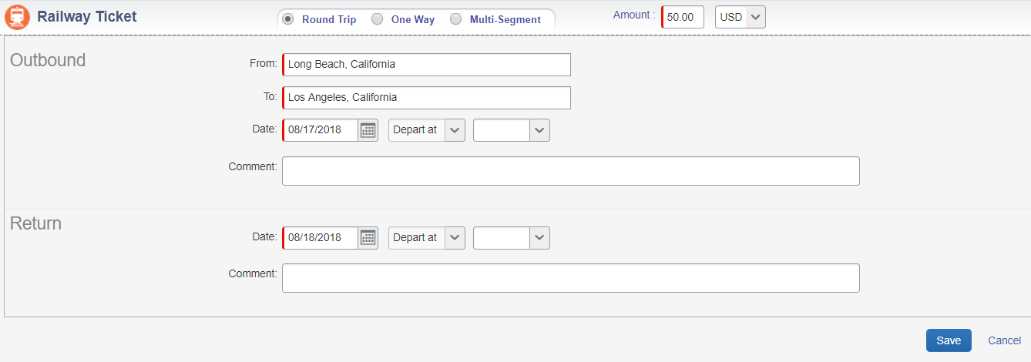
Rail
Fill in all estimated amount and optional fields if you like and click Save.
This segment is for train/Rail tickets in order to be eligible to book in Concur.
Enter an estimated Amount
Click Save.

Slide 27
Expenses
You can provide estimates for the following additional expense types:
Not all Expense Types are available in the request module. In this case, you can enter an estimated amount under Other Expense and then claim the actual expenses on your Expense Report to have the requested amount closer to the actual expenses.
After clicking on the Expense Type and entering the required and optional information if needed, you can then Allocate (if needed) and Save.

Slide 28
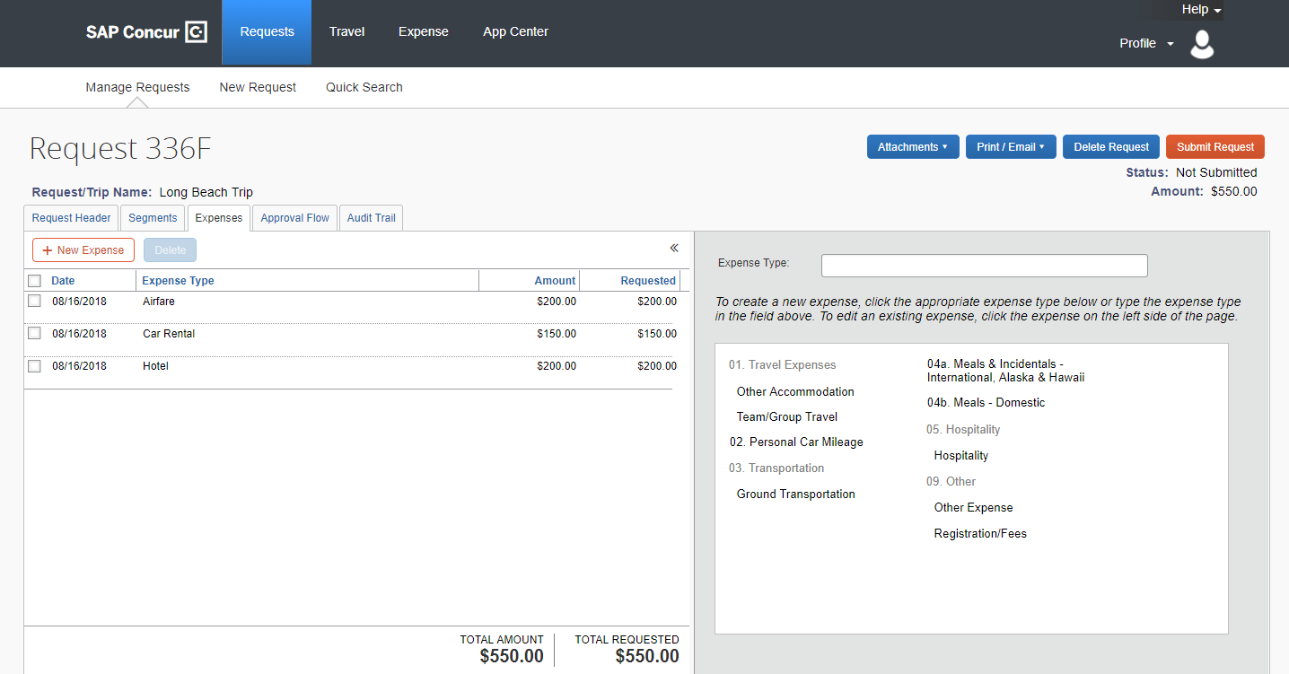
Expenses
Add your additional expenses. Once each expense is saved, it will appear on the left hand side.
If you need to attach a document, click on Attachments >Attach Documents.
Please Note: Attachments will not carry over to your Expense Report.
Need to add an attachment?
Segments will now be part of your expenses.
Click on each expense you want to add

Slide 29
Unfunded Travel
If you are creating a request for unfunded travel, please do the following:
Enter a comment regarding the travel being unfunded.
Enter an expense line under the Expense tab. If an expense line in not in your request it will not let you submit.
Chose Liability/Unfunded Only and enter zero dollars for the amount. Click Save and Submit request.

Slide 30
Travel Request Submission
After you have completed the Request Header, Segments and Expenses tabs, you can submit your request by clicking Submit Request.
Additional options:
Print/Email- PDF version of the Travel Request will pop up and you can make your selection.
Approval Flow- shows who approved the Travel Request and date.
Audit Trail- shows all actions of the Travel Request including comments added, approvals, forwarding, etc.
Delete Request – You will not be able to delete a request once the request is approved. However, you can cancel the request at anytime. You can also recall the request once you submit if it hasn’t been approved.
You can do this on the Expense side too!

Slide 31
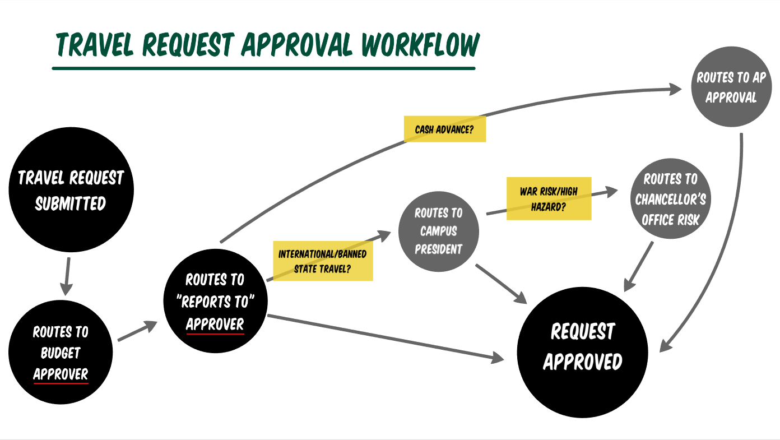
Travel Request Approval Workflow
Once you travel request has passed the approval workflow, you can book your trip!
Approval Workflow will route via email notifications.

Slide 32
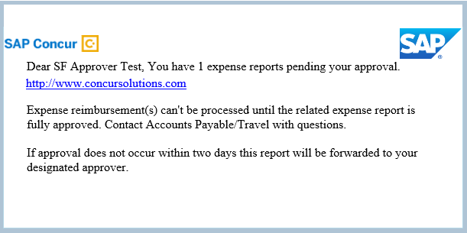
Approving a Travel Request/Expense Report
After a Travel Request/Expense Report has been submitted, the approver will receive an email including a link to log in to Concur, that a Travel Request/Expense Report is pending approval. Email notifications will continue throughout the approval workflow process.
Email Example Only
Quick Task Bar

Slide 33
Booking Travel via Concur Overview
Sac State has contracted Christopherson Business Travel (CBT) as our Travel Booking Agency. It is recommended to book travel (Airfare, Hotel and Car Rental reservation) through Concur. Either by using the online booking tool in Concur Travel or calling a CBT Agent.
In order to Book Travel via Concur your Travel Request must be approved prior to booking your travel reservations.
If you need to call a CBT Agent to book your travel, please make sure to provide the Request ID of your Travel Request. The Request ID can be found above the Request/ Trip Name of the request.

Slide 34
Booking Process
Step 1: Once Travel Request is approved…
To see status of request go to Requests > Manage Requests
Request is approved and travel is ready to be booked.

Slide 35
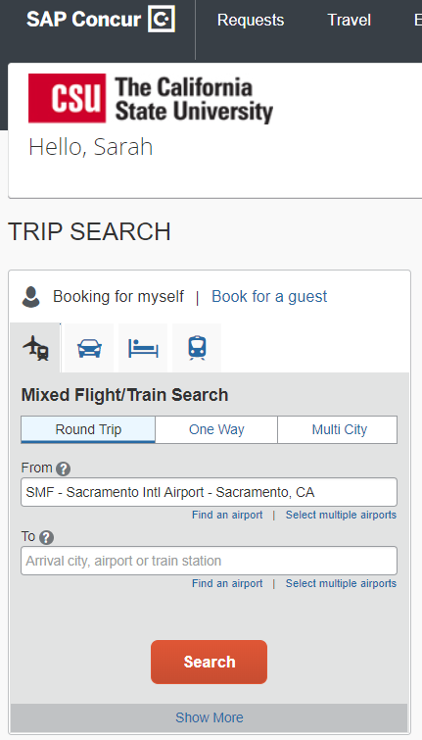
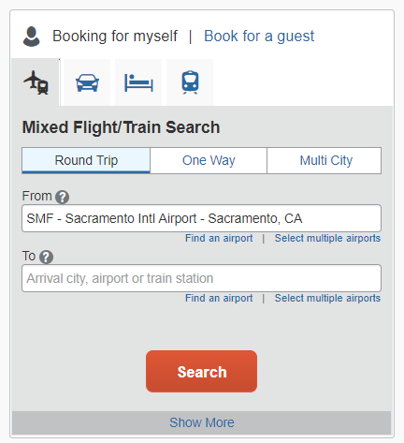
Booking Travel Reservations
Step 2: Booking your Segments
Start booking reservations through Trip Search or Travel tab
Select segment and enter in trip details to start looking up fares and complete the reservation process.
Airfare, Car Rental, Hotel, or Rail can be booked through the online booking tool.

Slide 36
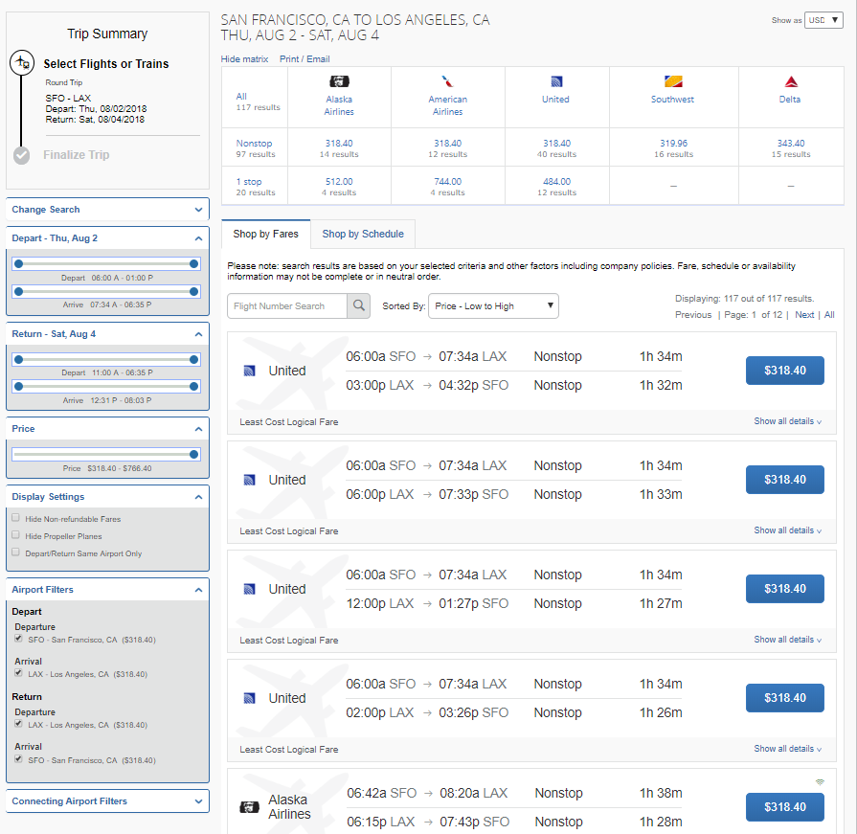
Airfare Reservation
Matrix available for easy view of availability
Coach or any other discounted economy class fare shall be selected that meets the traveler’s schedule needs.
The system will save the lowest cost airfare in the search results. For any flights with a price 20% greater than the lowest cost airfare, the system will display a warning icon (out of policy) next to the blue reserve button.
Your name in Concur is the name that will be on your airline ticket. If this is not the name on your photo identification you travel with, please contact the Concur Coordinator prior to booking your flight.
US Bank Travel Ghost Card will be automatically charged for airfare. University will prepay the expense and there is no reconciliation required on the department.
To edit search criteria, display settings and filters.
Choose to Shop by Schedule or Shop by Fares.

Slide 37
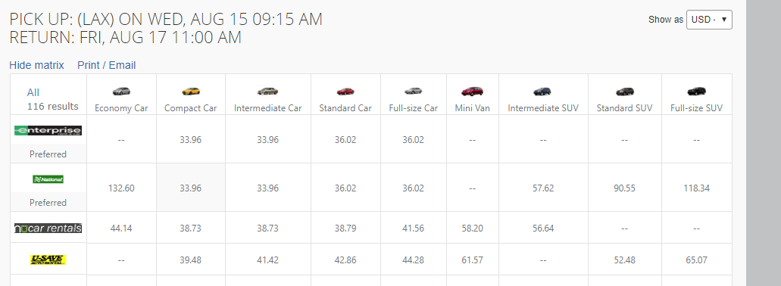
Car Rental Reservation
All Car Rental reservations should be booked through Enterprise or National as they are the contracted vendors by the CSU.
Rental up to an intermediate size vehicle is allowable under the CSU Travel Policy. Larger vehicles may be allowable if there is a no-cost upgrade provided or if the recommended sizes are not adequate to meet the business purpose of the trip.
Preferred vendors will list at the top of the matrix.
You do not need to add a card in order to book a car rental reservation. You will need to provide a credit card at the time of car pick up.
Matrix available for easy view of availability

Slide 38
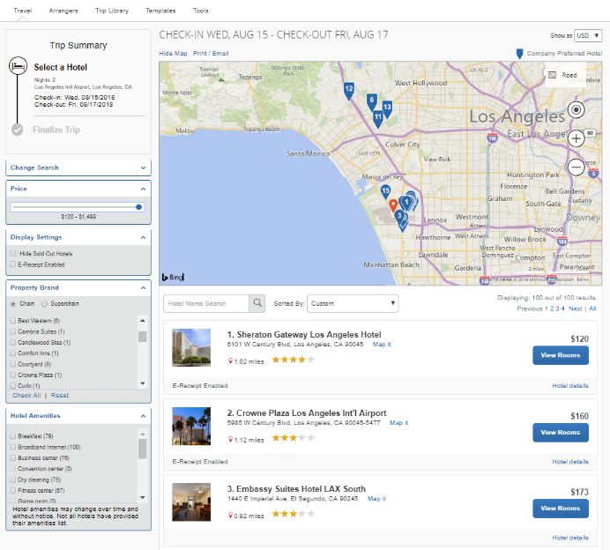
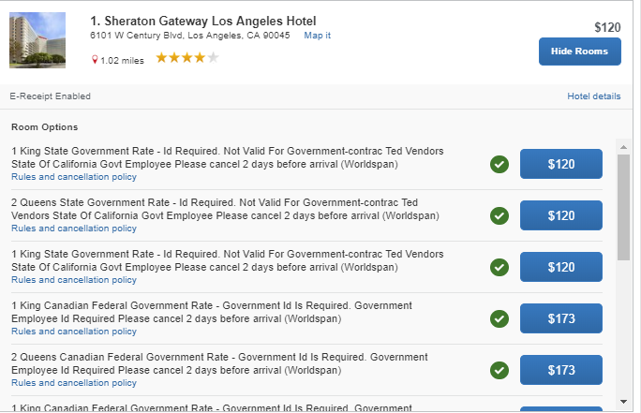
Hotel Reservation
Maximum nightly room rate is $275 before tax. If you book a hotel greater than $275 you will only receive reimbursement for the max rate of $275 plus any applicable taxes charged, unless an approved Exception to the Travel Policy form is attached to your Expense Report. Please acquire the approval prior to booking a hotel that is over the maximum nightly room rate.
If a conference is doing room blocks for their attendees, please do not book hotel through Concur. CBT is unable to access the discounted rates you would get with these room blocks.
You will need to add a credit card on file in order to guarantee your hotel reservation. This card will not be charged and you will need to supply a credit card in person at the time of check-in.
Make sure check the Rules and Cancelation Policy if you see this blue icon next to the amount. This means the room rate changes over the course of your stay and still within policy.
You can define your search results even more by using the radio buttons on the left hand side.

Slide 39
Creating a New Expense Report
Under Requests > Manage Requests, your active Travel Requests will be listed.
Select and open the request you want for the expense report you would like to create.
On the right-hand side click Create an Expense Report.
Now the Travel Request will automatically link to a new Expense Report as well as populate most required fields.

Slide 40
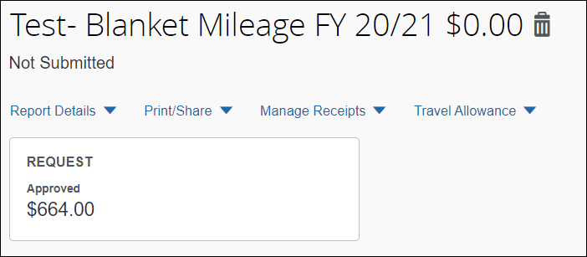
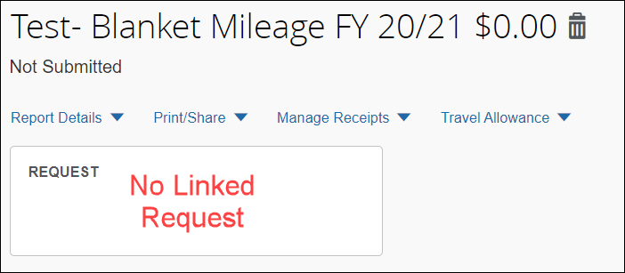
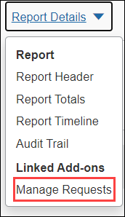
Expense Report Header
A Travel Request must be linked to your Expense Report, if there is no Request listed under Request Details, click Manage Requests, check the corresponding Request, and click Add.
Once a Travel Request is linked, all the header information from the request will move over and populate the required fields.
To update trip information such as dates or add comments. Click on the report name. This will open the expense report header where you can update the information.

Slide 41
Adding Expenses
The next step is to add all your travel expenses. The Expense Types include:
Within each Expense Type you can choose to Itemize, Allocate, and Attach Receipt.
Hotel Expense Type requires Itemization.
You must add a Personal Car in your User Profile in order to add Personal Car Mileage Expense Type.

Slide 42
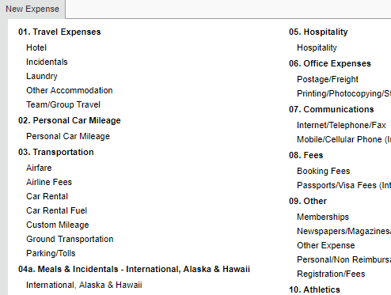
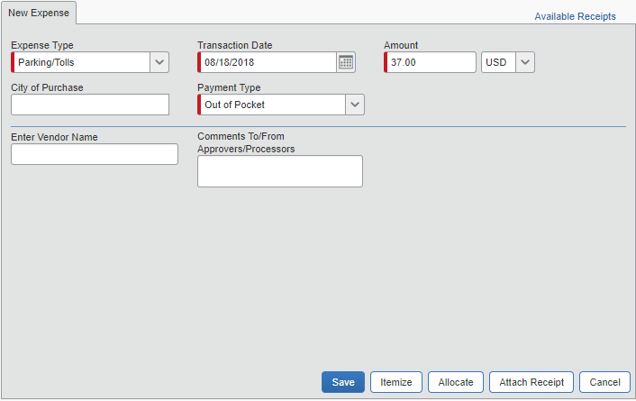
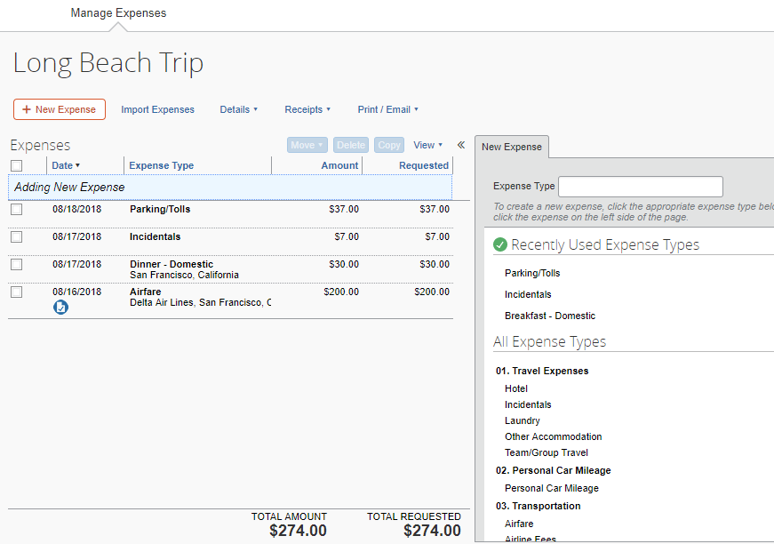
Adding a
Parking Expense
To add an expense, first click on New Expense. Then choose the Expense Type. Fill in information. Click Save.
You can also Itemize, Allocate, or Attach Receipt

Slide 43
Adding Expenses
Each Expense Type will have their own set of required fields and configuration.
CSU and campus specific audit rules are integrated in the system. When adding an expense that is out of policy or requires a certain action, an exception may trigger…
Warning- eligible to continue and submit.
Hard Stop- cannot move forward and must make correction prior to submission.

Slide 44
Adding Expenses
All Expense Types require a Payment Type. The Payment Type will default to Out of Pocket, unless it is a US Bank Travel Card transaction in which it will default to CSU-US Bank.
Out of Pocket – all expenses incurred out of your own pocket. For example: personal credit card, cash, etc.
CSU-US Bank (Travel Ghost & Individual Card)– Travel paid by US Bank Travel Card (Airfare booked via Concur Travel) All US Bank Travel Ghost Card transactions will be uploaded to Available Expenses once posted. From there, you can add the transaction to your Expense Report.
University Paid – expenses paid by the university, either by Pro Card, Dept. Travel Card, Direct Pay/Bill, etc.

Slide 45
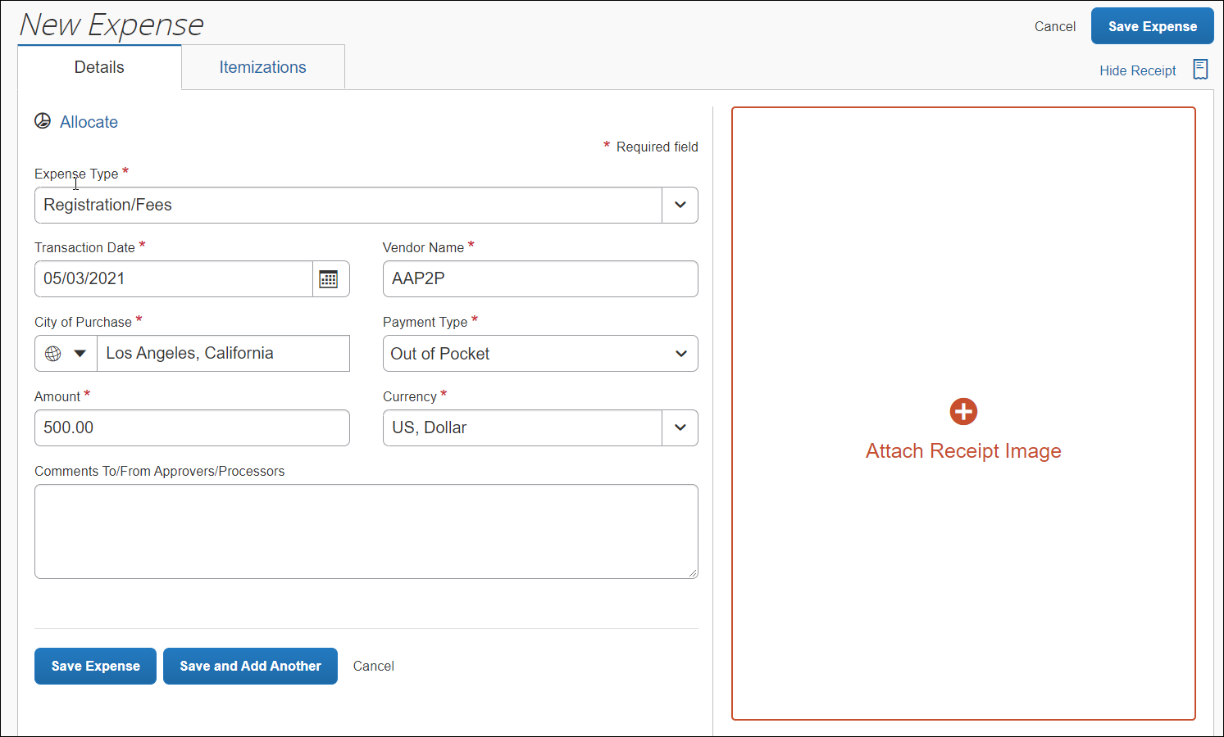
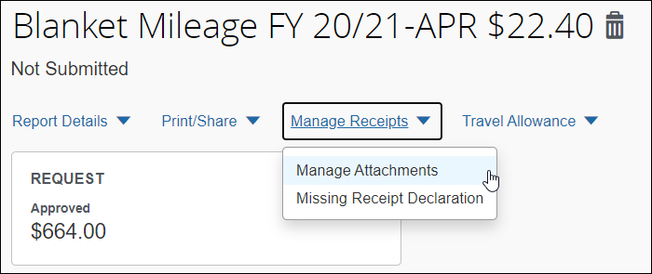
Attaching Receipts/Attachments
There are several ways to attach a receipt:
Scan, Save and upload from your computer.
Scan and email to receipts@concur.com.
Forward emailed receipts to receipts@concur.com.
Take a picture using your phone and to email and submit via Concur Mobile App.
Attaching a receipt to an individual transaction:
Select the expense type transaction, then click the Attach Receipt button on the right-hand side.
Browse, locate, and upload the image from your files.
Choose an image from your Available Receipts.
To add an attachment, other than a receipt, click Manage Receipts > Manage Attachements.

Slide 46
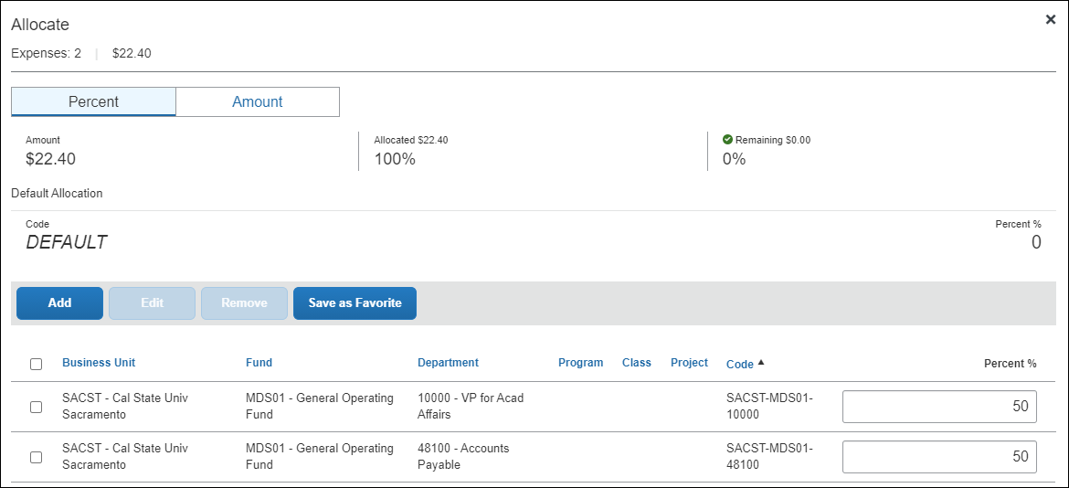
Allocation
All expenses will be charged to the chartfield indicated on your Expense Report Header unless allocated.
You can either allocate by Percentage or Amount.
We recommend to allocate at the end after all your expenses are entered.
Select the expenses, by clicking the check box, then click Allocate.

Slide 47
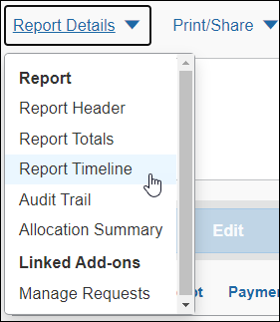
Expense Report Submission
Expense Reports must be summited within 60 days from the trip end date.
To submit the Expense Report, on the Expense Report page, click the Submit Report button. All red exception flags must be cleared before the report can be submitted. Yellow flags are considered warnings but will not stop the submittal process.
To see who is approving your reports or to see where your report is in the workflow, open the Expense Report, click Details > Report Timeline.

Slide 48
Expense Report Approval Workflow

Slide 49
Processing
If there are any issues with your Expense Report, your report will be sent back along with comments. Once complete, please resubmit your Expense Report so it can go through the approval workflow again.
Once your Travel Expense Report is fully approved, Travel will process and your reimbursement will be on its way by either Direct Deposit (EFT)* or mail!
*Direct Deposit for reimbursement is different than Paycheck EFT. You must enroll through Accounts Payable/Travel. It’s easy to enroll! Click here to fill out the form. Email completed form to m.adams@csus.edu for processing.

Slide 50
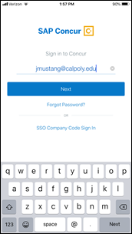
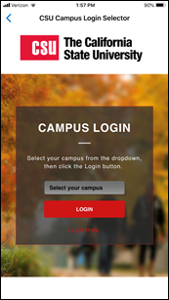
Concur Mobile Application
Step 1: Download the Concur application on a phone by going to the App Store and searching for SAP Concur.
Step 2: Login to the Concur Mobile App.
Open the Concur app and sign in with your Sac State email address.
In the CSU Campus Login, select Sacramento.
Enter in your Sac State User Name and Password.
Step 3: Welcome to the Concur Mobile App. The App home screen provides access to your trips, expenses, expense reports, approvals, and more.

Slide 51
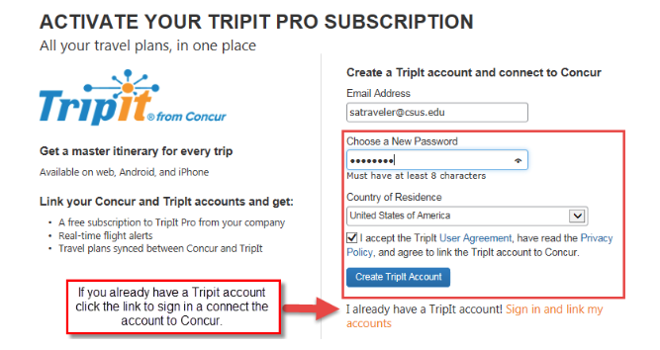
TripIt Mobile Application
Step 1: Download TripIt App for your device.
Step 2: Locate Tripit eligibility message on Concur home page, under Alerts.
Step 3: Click Learn More and Activate link.
Step 4: Enter your @csus.edu email address, and a password, and click Sign Up.
Step 5: Tripit will send a verification email to your @csus.edu email address.
Step 6: Click the link in the email to verify the account.
For reservations outside Concur, email itinerary to plans@tripit.com to integrate them into this app for easy recall.

Slide 52
Need More Information?
For more in-depth information regarding Concur Travel & Expense, please check out the Concur Resources at: https://www.csus.edu/administration-business-affairs/internal/concur-travel/
Questions? Email sacstatetravel@csus.edu

