Slide 1

Expenditure Transfer 101
Thursday, November 17, 2022
Accounting Services
Notes:
Welcome to Expenditure Transfer 101
This training is being Recorded and will be available on the AS webpage
Introduce Team –
Please place any questions you might have during this training in the chat
Todays training will include the OnBase updates

Slide 2

EXPTX Training Agenda
What is an Expenditure Transfer?
Types of Transfer Requests Exist
Who can submit an EXPTX Request (Delegation of Authority)
How to submit an EXPTX Request (OnBase Form & Email)
Tips & Tricks
Quarterly Reporting Review & Deadlines
Resources
Notes:
In this training we will be covering

Slide 3
What is an Expenditure Transfer?
Basic definition: Moving a posted expense from one chartstring to another
  You’ve identified an expense that was charged to the wrong fund, department, account, or without a class code, project code, etc.
    Last resort correction when a Purchase Order (PO) or voucher amendment is not an option, or you’ve missed the deadline to reconcile the Procard statement
    To correct a Campus Cost Recovery (CCR) chargeback when the service provider is not able to correct them via the CCR process
    To correct fund for travel expenses initiated in Concur
  You want to split an expense between multiple chartstrings
  You want to reclassify an expense, e.g., change from Supplies and Services (660003) to I/T Software (616003)
Notes:
An Expenditure Transfer is moving a posted expense from one chartstring to another. It can be used when you’ve identified an expense that has been charged to the wrong fund, department, account, or without a class code etc.
Expenditure Transfers can be used when a PO or voucher amendment is not an option or to correct a CCR when the service provider is not able to correct them via the CCR process.
In regards to concur please make corrections to the chartstring prior to approving the travel claim for reimbursement. This is extremely important because one error can cause a massive amount of Expenditure Transfers needed

Slide 4
Types of Expense-to-Expense Requests:
Full Transfer
    Move entire expense that was posted to the wrong fund, department, account, or without a class code, project code, etc., to correct chartstring
Cost Share
    Split an identified expense between two or more chartstrings, e.g., supplies and services shared between two different courses within a college/department
Notes:
There are two types of requests when dealing with making a change from one expense to another expense. They are Full transfer and cost share.
A full transfer is when the entire expense that was posted is moved
A cost share is when the expense is split between two or more chartstrings.

Slide 5
Other Types of Transfer Requests: Cannot be done in OnBase
Cost Recovery (Service Provider Use Only)
    Used for service provider chargebacks.
    Account codes used are restricted to 617xxx for expense and 580094 or 580095 for reimbursement
    SACST Campus Cost Recovery/Chargebacks Transfer Request
    Transfer of Prior Year expenses
    Move an expense that occurred in a prior year
    The Excel Expenditure Transfer Request Form must be completed and submitted to Accounting Services, as OnBase only retrieves current year transactions
    Requires Accounting Services manager approval
    SACST Expenditure Transfer Request
Notes:
Other types of transfer requests that can’t be done in OnBase are cost recovery and prior year transfer.
Cost Recovery requests are used for service provider chargebacks
Examples of Service Providers are Housing, IRT, Facilities, Parking, and Print & Mail
OnBase can’t be used for transfer of prior year expenses. If you need to make a prior year transfer, complete the Excel Expenditure Transfer Request form and submit it to Accounting Services.

Slide 6
Other Types of Transfer Requests: Cannot be done in OnBase
Revenue Transfers
    Used to correct revenue transactions
    Use Excel Revenue Transfer Request Form and not OnBase
    SACST Revenue Transfer Request
Sponsorships
    Provide funding to other departments in support of mutually benefitting events
    Use Excel Sponsorship Transfer Request form and cost recovery account codes
    SACST Sponsorship Transfer Request
Notes:
Other types of transfer requests that can’t be done in OnBase are revenue transfers and sponsorships.
Revenue Transfers are used to correct revenue transactions. Sponsorships provide funding to other departments.
Examples of Sponsorships are University Foundation and Athletics

Slide 7
Delegation of Authority (DOA) in DART (CMS)
Who can submit an EXPTX Excel Request?
Anyone on campus can submit an Expenditure Transfer Request, but if the requestor doesn’t have Delegation of Authority (DOA), an approval document (e.g. email) must be attached to the request from the official(s) having DOA for the department(s) being charged.
Refer to Common Access Request System (CARS) to establish DOA
To search fiscal authority for each department navigate to CMS. Refer to
DART User’s Guide for more guidance on different ways a search could be conducted.
  The employee being charged, who is either a requestor or who is included with EXPTX request, must have a DOA for “Expenditure Transfer Approval”
Continued…
Notes:
Who can submit an Expenditure Transfer request outside of OnBase?
The requestor must have Delegation of Authority or DOA. If you are submitting the request and do not have DOA then an approval document such as an email from someone who does have the authority, must be attached to the request.
To establish DOA please refer to the common access request system or CARS.

Slide 8
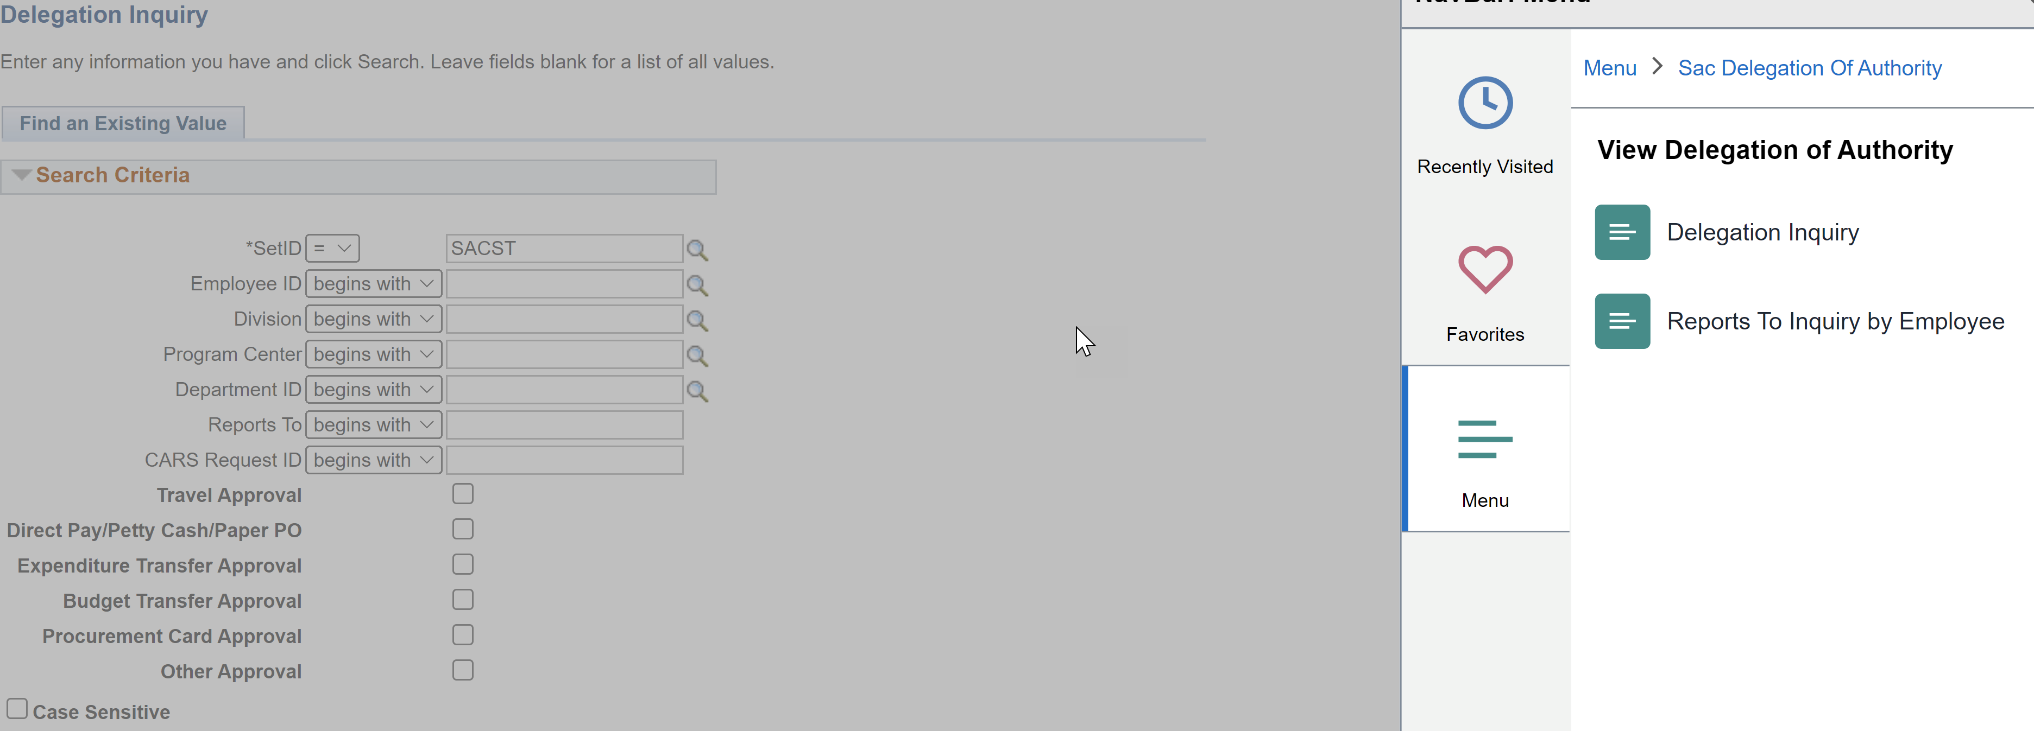
Delegation of Authority (DOA) in DART (CMS)
In CMS…
Notes:
To get to Delegation Inquiry in CMS, follow the navigation on this page.

Slide 9

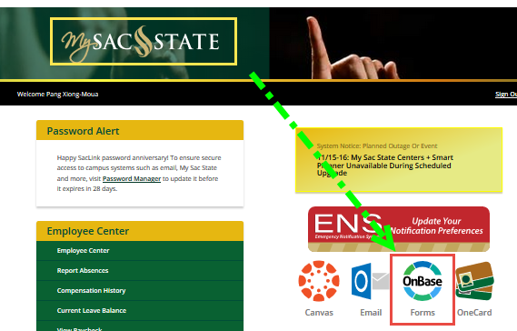


Access (EXPTX) Form
Do you have Expenditure Transfer Delegation of Authority (ET DOA)?
  To check the current list of DOAs navigate to CMS >Sac Delegation of Authority>View Delegation of Authority>Delegation Inquiry
To access the form log in to My Sac State>Staff Services>My Forms>Expenditure Transfers or follow this link, https://onbase.csus.edu/unity/forms/ExptTransfers.aspx. Open the form in the Chrome browser for full automation functionality.
Notes:
Walk users through a live submission

Slide 10
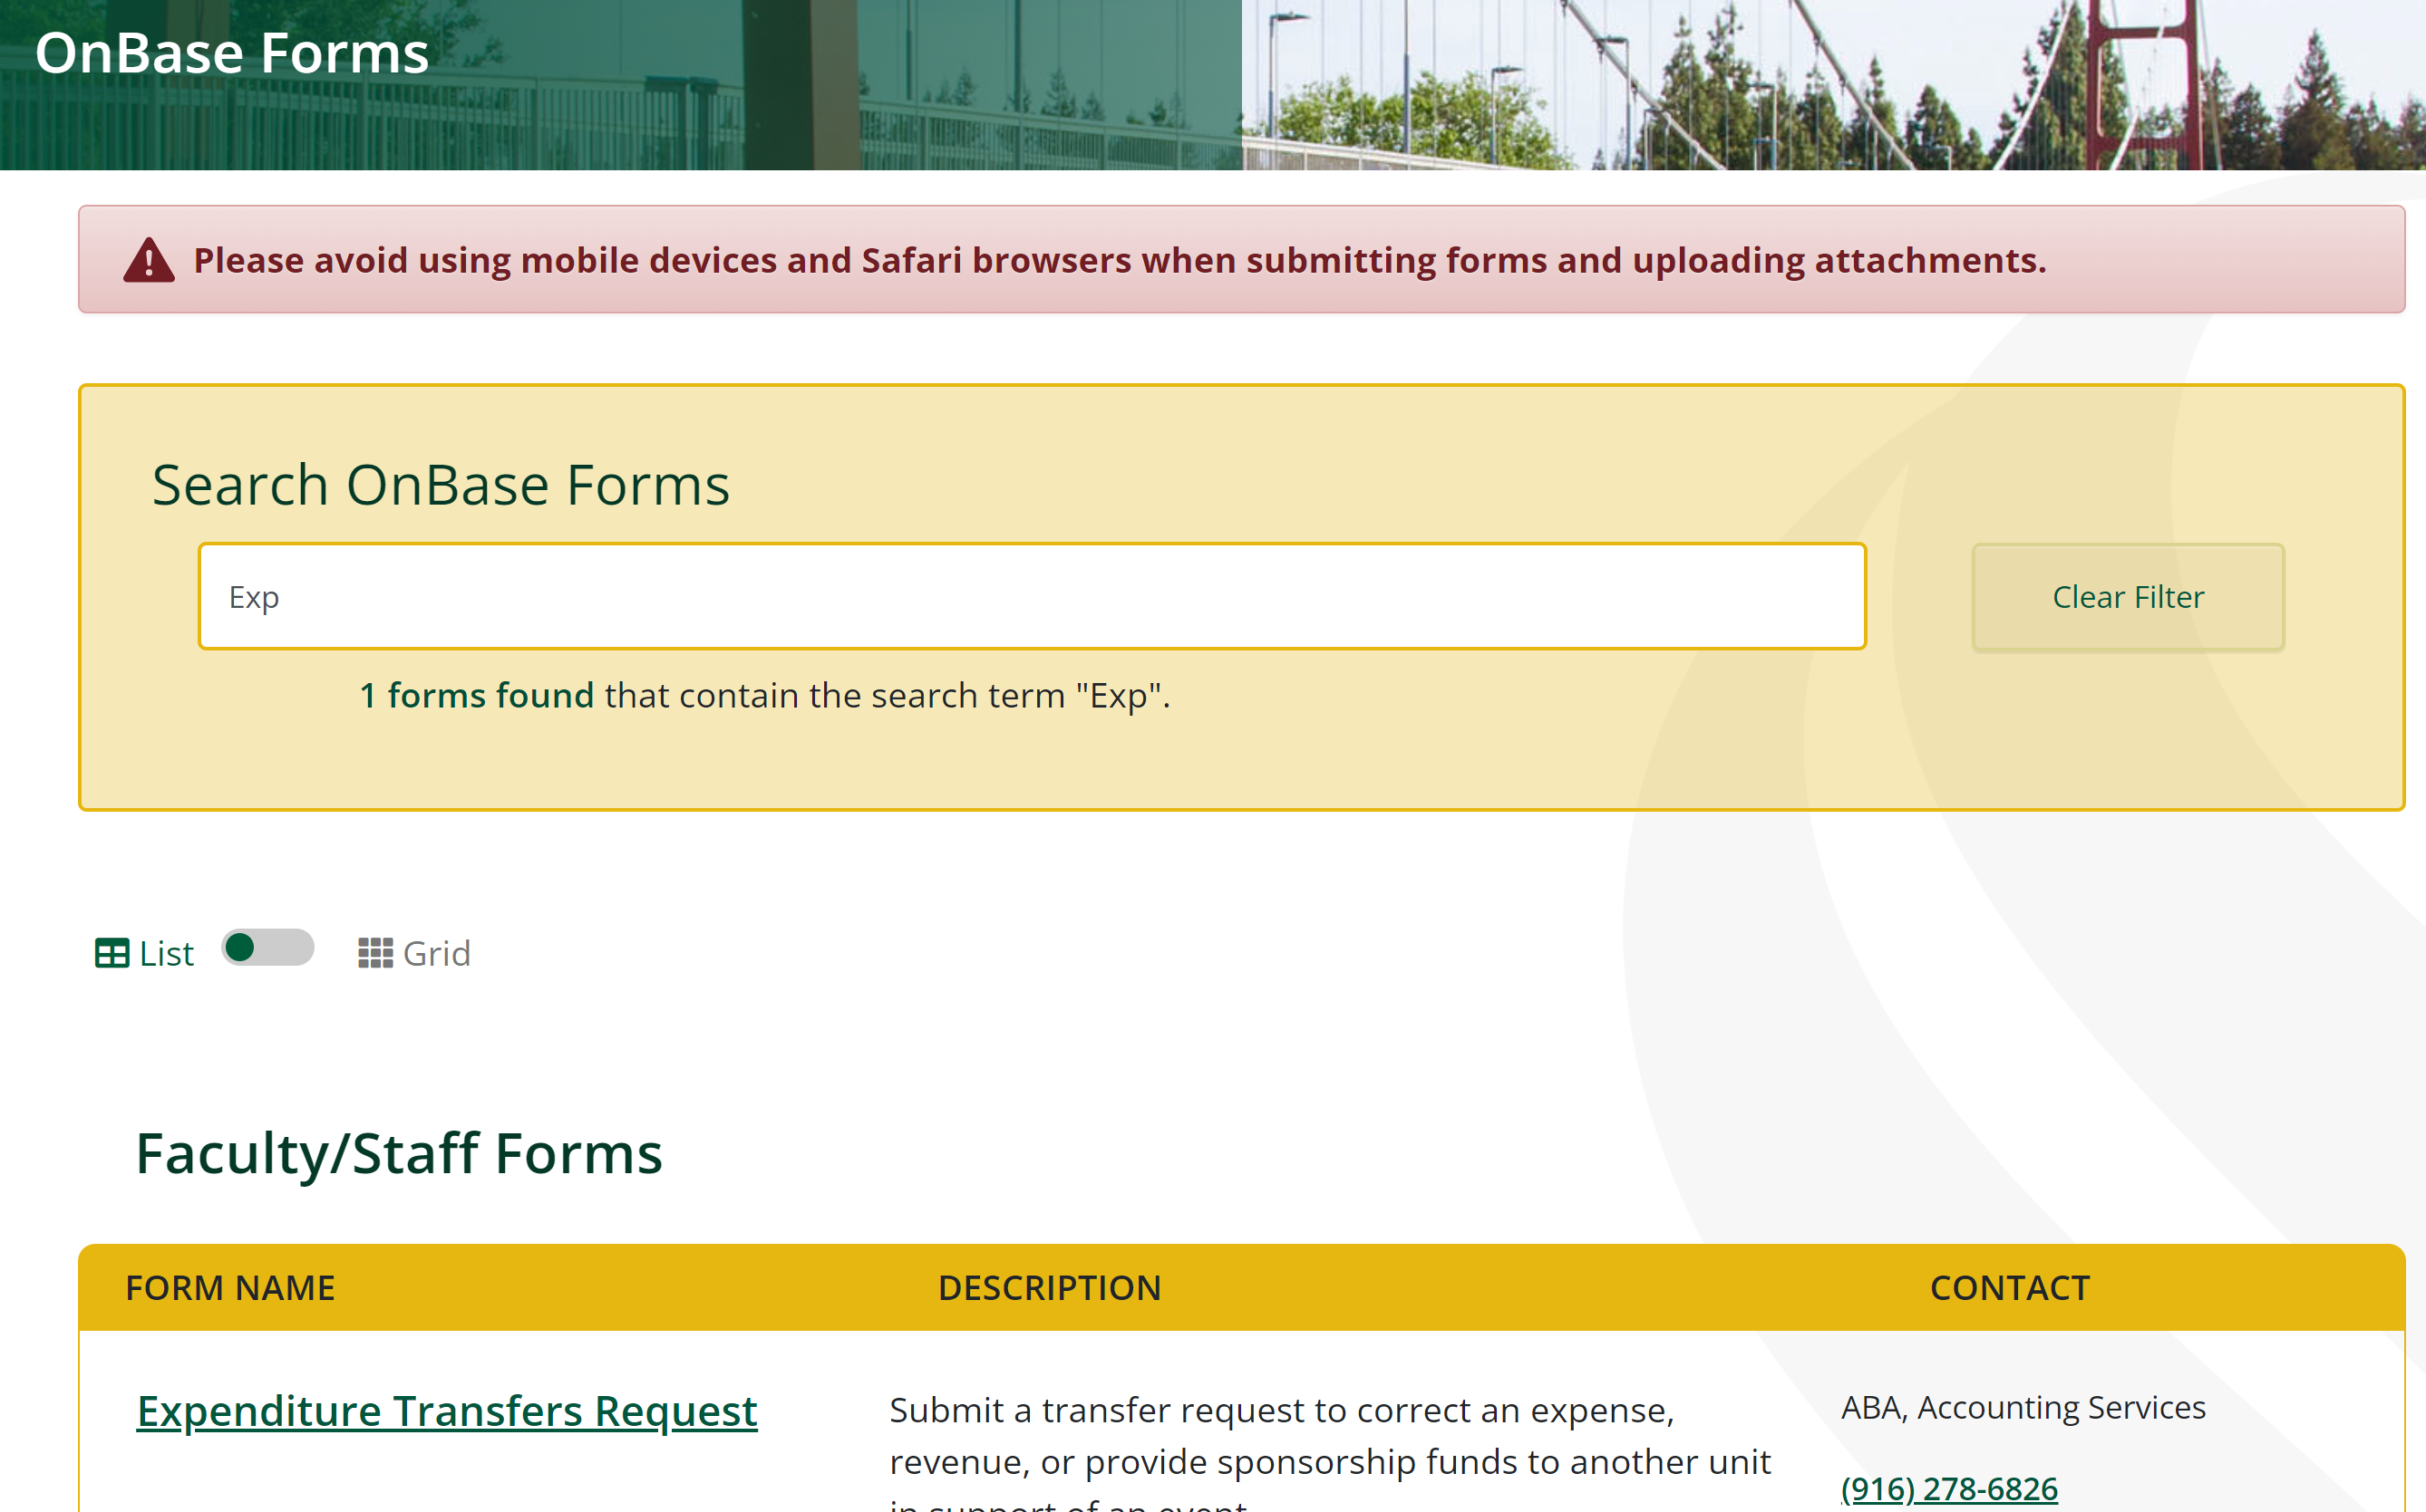
Access (EXPTX) Form
If you cannot see this form in your list, please speak to your manager and submit a CARS request.
Notes:
Please contact your manager if you don’t see the form listed, so they can submit a CARS request

Slide 11
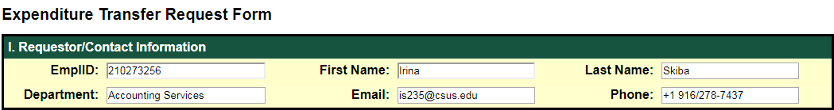
Step by Step Instructions:
Section I
Requestor/Contact Information
      All auto-populated fields from campus directory
      Fields are locked to preserve the security of the DOA
      Requires log in with My Sac State credentials
      Enter all data with CAPS LOCK on

Slide 12
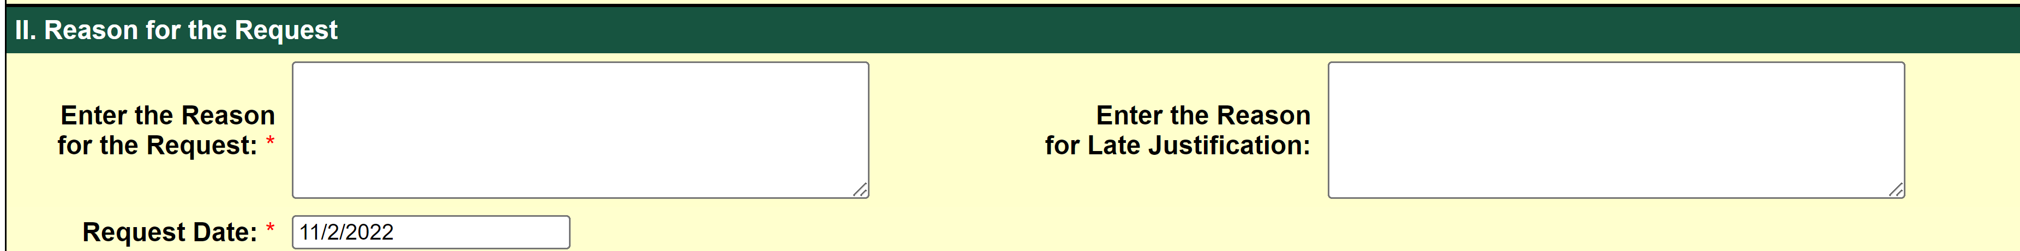
Step by Step Instructions:
Section II
Reason for the Request
  Enter a detailed explanation for the transfer.
  We need who, what, why, and when.
  The first 30 characters will get posted in CFS, but enter as much detail as possible.
  DO NOT HIT ENTER! Let the text wrap.
  The request date will auto-populate with the current date.
  Only use the Late Justification box if the request is after the quarter close deadline.
Notes:
Reason: Be as thorough as possible but remain precise since only 30 characters will be posted in the general ledger

Slide 13
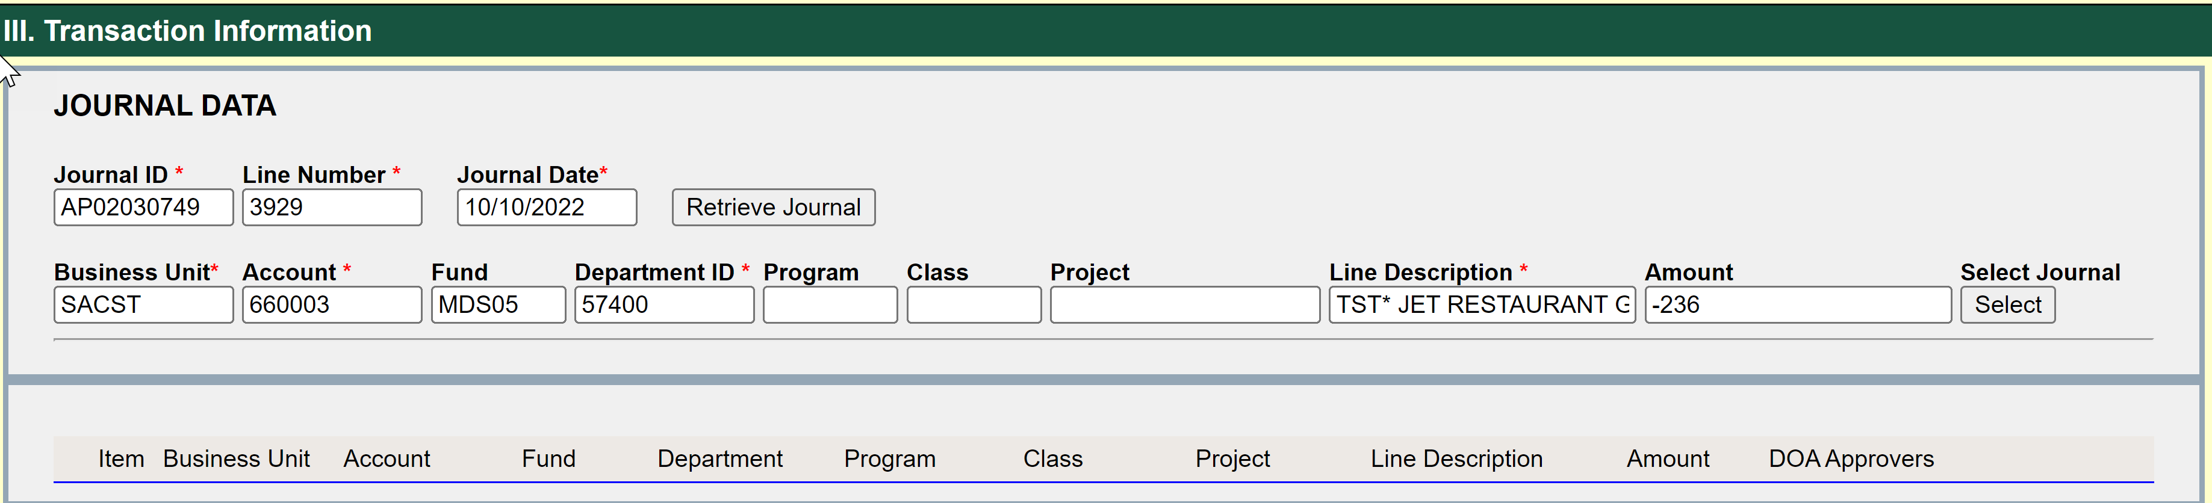
Step by Step Instructions:
Section III
Journal Data
  Enter the Journal Entry ID. Do not hover over the fields.
  Select the Journal Entry from the drop down menu and tab out of the field.
  Enter the line number you wish to correct and tab out of the field.
  Click on “Retrieve Journal”.
  Journal date and chartfield data will auto-populate. Please verify that this is the entry you want to change. Click on “Select Journal”.
Notes:
Section III: Transaction Information
Enter Journal ID & Journal Line Number and click “Retrieve Journal” button
The chartstring associated with the journal ID and the line number will auto-populate and reverse the sign for the amount
Press “Select” to advance to Transaction area for editing
For full transfer requests click “Add” to move the original chartstring to the journal entry area on the very bottom
For partial transfer requests modify the amount in Transaction area first, then select “Add”
You may choose to customize the line description within the 30 character limit
Enter the offsetting chartstring where the charge will be going in the Transaction area
Select the DOA(s) from the dropdown
Ensure that Transaction Balance is “0” and then “Submit” the form

Slide 14

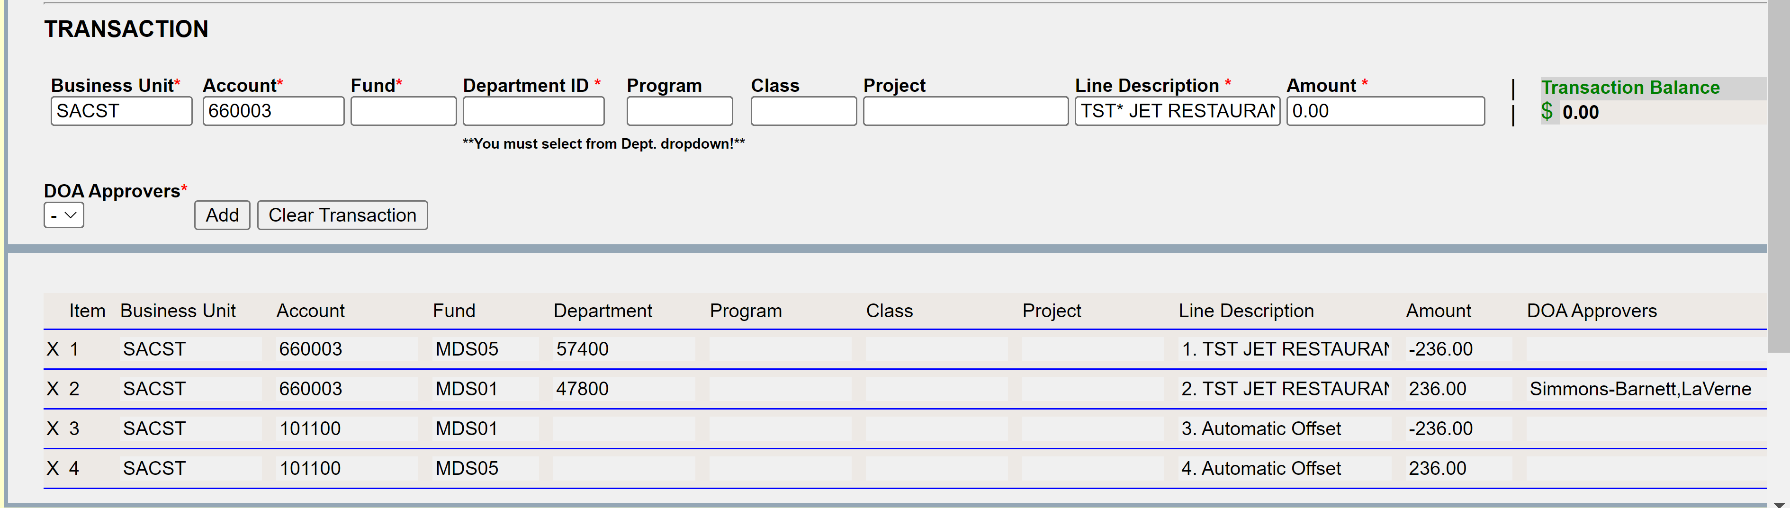
Example: Full Amount Transfer
Transaction Data
  OnBase will auto-populate the amount with a “-” to reverse the amount out. DO NOT CHANGE THIS SYMBOL. Let OnBase do the calculation.
  Click on “Add”. OnBase will auto-populate the line information in the section below.
  In the “Transaction” section, enter the correct chartfield data and the amount.
  Select “DOA Approver” from dropdown list. Click on “Add”.
  If OnBase auto-populates lines with 101100 accounts, Do Not Delete
Notes:
Full Amount Transfer:
Correcting a Dept ID for a travel charge.
The total cost of the expense was $3,000. Full amount is being transferred to 606002 MDS01 47800. Different fund auto-populated a cash offset (101100).

Slide 15
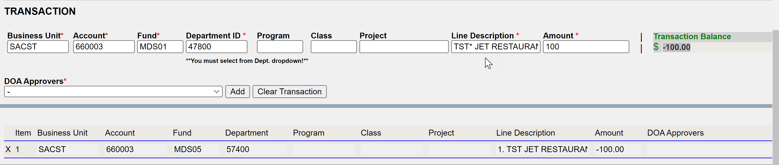
Example: Cost Share
Transaction Data
  OnBase will auto-populate the amount with a “-” to reverse the amount out. DO NOT CHANGE THIS SYMBOL. Enter the amount you want to move.
  Click on “Add”. OnBase will auto-populate the line information in the section below.
  In the “Transaction” section, enter the correct chartfield data and the amount.
  Select “DOA Approver” from dropdown list. Click on “Add”.
  If OnBase auto-populates lines with 101100 accounts, Do Not Delete!
  When completed correctly, the “Transaction Balance” will be zero.
Notes:
Cost Share (partial amount):
Library allocates a portion of Travel charge to Accounting Services
The total cost of the expense was $3,000. A partial amount ($2,000) is being transferred to 606002 MDS01 47800.

Slide 16
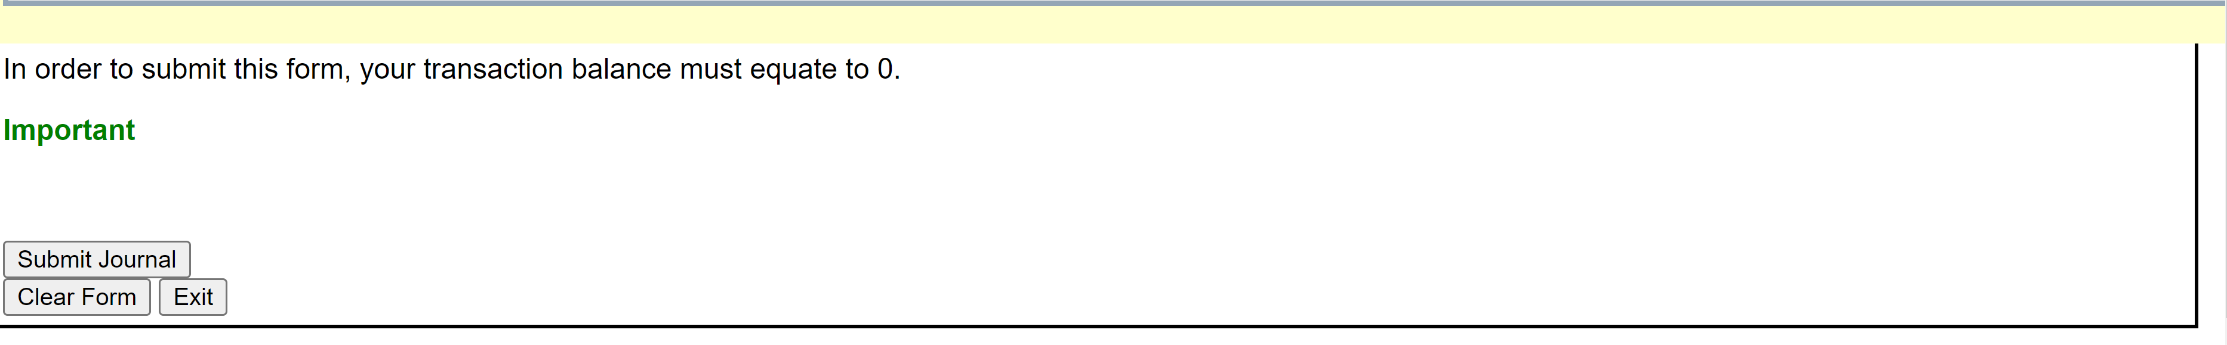
Step by Step Instructions: Completion
Completion Section
  If all data is accurate, Click “Submit Journal”. You will not be able to click this if a required field is blank.
  Transaction data will clear and you will be able to enter another transaction.
  If you need to start over completely Click “Clear Form”. This will clear data in Sections II and III
  When you are ready to leave the form Click “Exit” to close.
  Once Submitted – Requester, DOA, and Accounting all receive notification of submission.

Slide 17
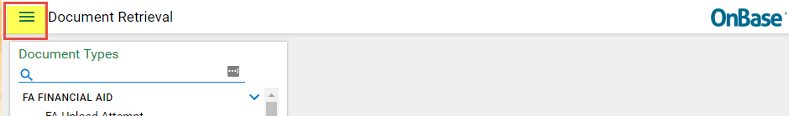
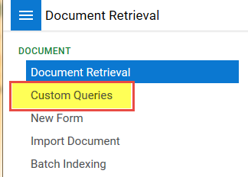
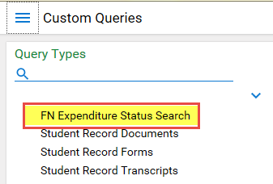
Status Updates
You can always check the status by going to https://onbase.csus.edu and searching in Custom Queries.
  Document Retrieval>Custom Queries>FN Expenditure Status Search.
Users will receive emails as the status changes
  Once Approved and Posted to CFS the email will include the Journal ID
  If denied, the email will have the reason and name of the Accountant to contact for help
  If a correction is needed, the email will have a link to make corrections
*** Note: Opened forms stop the workflow, so don’t forget to close the form after viewing!***
Notes:
Will show them this part in the Live walkthrough.

Slide 18
Form Tips & Tricks
Business Unit: Transfers within SACST business unit only. No SAFDN expenditure transfers to be submitted via OnBase.
Can I save the form? No, but the form doesn’t expire unless the window is closed.
Timing difference effects on OnBase Form - Approved and processed Transfers should be available in CFS/FDW/CDW within 2 days of receipt of email.
Create IRT Service Now ticket if there are any problems with the OnBase form https://www.csus.edu/irt/
  OnBase works best in Chrome or Firefox, please make sure you are in one of these browsers before contacting IRT.
Audit & Validation Rules enforced by OnBase Form:
  Quarterly submission deadlines are enforced. OnBase will check the request date, journal date and the quarterly deadline. All late requests will require a reason in the box.
  MDR01 must have a reimbursed activity class code that begins with “0” and ends with “A”. You will get an error message if it does not. Codes ending not in “A” will also error.
  Accounts with 601xxx, 603xxx are for salary, and will be reviewed by the Budget Office first once the form is submitted.
Notes:
We encourage everyone to constantly submit their EXPTX to avoid late submissions and long processing times.
Accounts with 601xxx, 603xxx are for salary, and will be reviewed by the Budget Office first once the form is submitted.

Slide 19
EXPTX Tips & Tricks
Submit EXPTX Monthly
Federal Work Study EXPTX are not allowed (Accounts: 602001 and 602002)
  For questions please contact Jennifer Barrett, x86020 or barrettj@csus.edu
Construction related EXPTX
  For all construction related questions and requests, please contact Hai Ly, x87230 or via email lyht@csus.edu
  Expenditures in claimable funds must be moved via voucher adjustment (e.g. DMxxx, DCDxx). Refer these to LaVerne Simmons-Barnett, x87009 or via email barnettl@csus.edu
Payroll EXPTX (Accounts:601xxx or 603xxx)
  Contact the Budget Office to determine if corrections can be made via LCD Adjustment or EXPTX Transfer
  Interagency Fund Transfers (IFT) journal entry corrections must be submitted to Accounting Services (accountingsevices@csus.edu) for review and processing. [JE#: xx009, xx099, Source: IFT]
  Non MDS01 funds must have enough Cash (101100) available to cover the expense
  Only move an expense (617xxx) posted via the Cost Recovery process to another expense (617xxx) account.
Notes:
More tips and tricks
Submit your requests monthly. Review your financial statements on a monthly biases or at the very least quarterly.
Federal work study Exptx are not allowed.
Construction related Exptx must be submitted to Hai Ly
Contact the budget office to confirm if Payroll Exptx corrections can be made

Slide 20
University Foundation at Sacramento State (UFSS) expenditure transfers cannot be processed via OnBase
An Excel transfer request form must be completed and submitted to ufssaccounting@csus.edu
The form is available on the ABA Forms webpage under University Foundation at Sac State (UFSS) https://www.csus.edu/administration-business-affairs/internal/_internal/_forms/05012020-safdn-expenditure-transfer-request-form.xlsm
UFSS Excel Transfer Form
Notes:
Foundation Exptx can not be submitted on OnBase. This form can also be found on the ABA webpage and submitted by emailing the request and backup documents to the UFSS accounting email.

Slide 21

Expenditure Transfer Request Deadlines
Posted Expenses | Transfer Request Submission Deadlines *
1st QTR: July-September | Last business day in October
2nd QTR: October-December | Last business day in January
3rd QTR: January- March | Last business day in April
4th QTR: April – June | Please refer to Year-End Dept Deadlines on Accounting Services Website
Changes for the year will not be allowed in the system after the year ends on June 30th. I f you try and submit, it will error out. Please submit these via Excel & Email.
Notes:
Here is a breakdown of the Exptx request deadlines.
Year end dept deadlines can be found on the accounting services webpage.

Slide 22
Questions and comments may be sent to accountingservices@csus.edu
Questions ?
All trainings are located on ABA-Financial Services website
https://www.csus.edu/administration-business-affairs/financial-services/
Thank you!

