Slide 1

CourseMatch Program
Sharyn Gardner
Director of Undergraduate Studies
Academic Affairs

Slide 2
Overview
What is CourseMatch?
CourseMatch criteria
Application process and steps

Slide 3
What is CourseMatch?
Graduation Initiative 2025 strategy
Goal to increase CSU’s capacity in high-demand courses
Focus (priority for approval):
  Fully online asynchronous GE courses (articulated)
  Low DFW rates (grades)
  Will consider lower division major requirements

Slide 4
Why Participate?
Assist students across CSU in fulfilling GE/lower division major preparation coursework
Ease bottlenecks at other CSUs
Facilitate students finishing degree more efficiently
CourseMatch enrollment FTES neutral

Slide 5
CourseMatch Criteria
Course instructor must have QM training or equivalent – list in Qualtrics submission
Course must be fully online and ASYNCHRONOUS
Must be evidence course has success rate comparable to FTF or history of success over time (e.g. DFW rate 15% or less)

Slide 6
Application Process
Complete Qualtrics survey (link on CourseMatch page reached from CTL homepage)
– Upload info and documents within Qualtrics
Submit completed survey by deadline
Notified within a few weeks if course approved
CourseMatch enrollment begins approximately December 1 for Spring and July 1 for Fall semesters
NOTE: Students enroll after their regular enrollment period -- up until the end of the second week of semester

Slide 7
What We Need for Application
Completed Qualtrics Survey
Repeatable grade % of fully online section and FTF/hybrid sections (DFW rates)
Procedures to ensure academic integrity of student performance (e.g. TurnItIn, proctored exams)
Syllabus

Slide 8
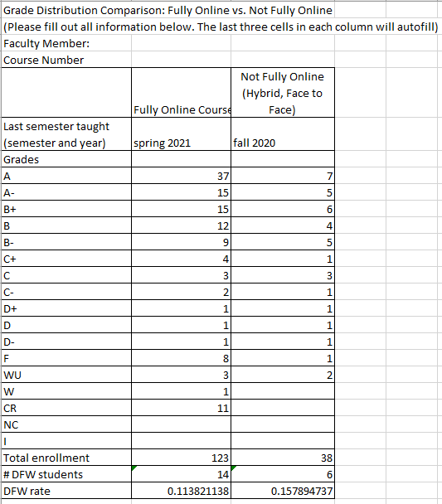
Grade distribution comparison:
Fully online vs. Not fully online

Slide 9
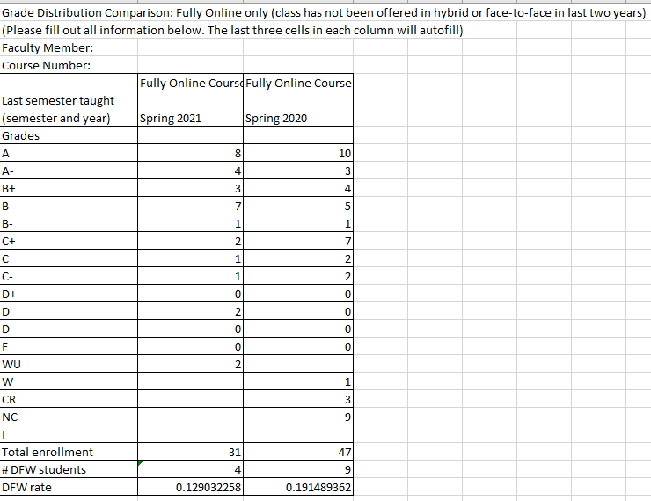
Grade distribution comparison:
Fully online only

Slide 10
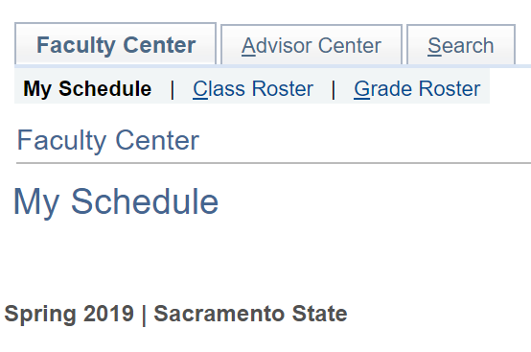
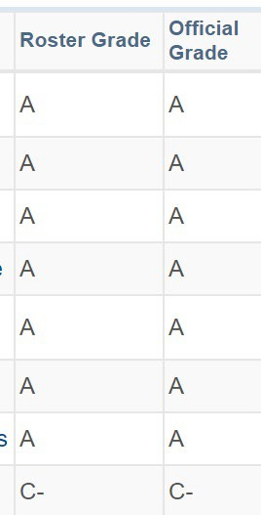

How To Obtain DFW Rate
Use own grade roster from prior semesters
Access via Faculty Center – go to semester last taught course
Click on grade roster icon
Enter grade counts into template; DFW rate automatically calculated
OR…use the grades in your Canvas course(s); both can be sorted

Slide 11
How To Obtain DFW Rate
Can show three of own prior semesters taught
Or compare to other face-to-face course sections from prior three years
Can compare your own online vs face-to-face
But if need to compare to other faculty’s section, will need assistance from department chair or ASC to access other sections’ grade rosters

Slide 12
Summary
Ensure Qualtrics application is complete by the deadline
Collect grade distribution data for DFW rate – ask me for help if needed
Notified when application submitted and when course is approved / not approved for CourseMatch

Slide 13
Online Teaching
CTL provides opportunities to support online teaching
Quality Assurance team
Course review and training opportunities
More information on Online Course Services page on Sac State’s CTL website.

Slide 14

Thank you
Please direct CourseMatch questions to:
Sharyn Gardner
gardner@csus.edu

